Slide 1


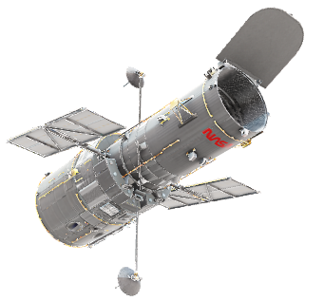
Project Gaia
Dong-Yoon Kim, Woo-Young Park, Jin-Sung Kim, Su-Min Oh, Alfred Cueva
Seoul National University, Seoul, Korea
2022.11.17

Slide 2
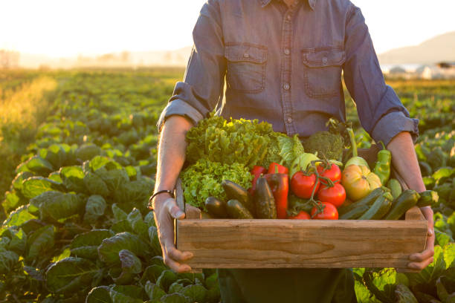
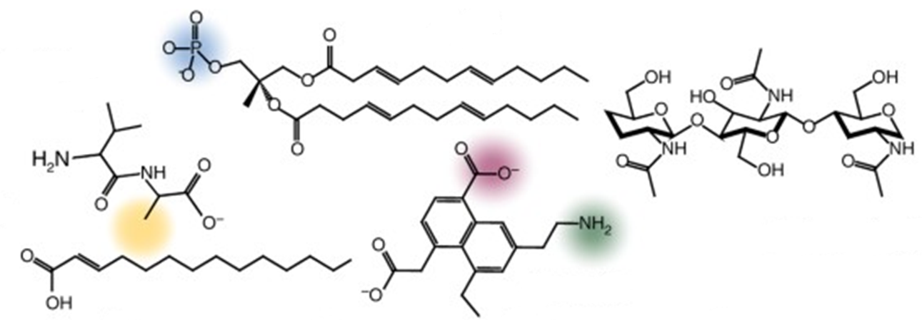
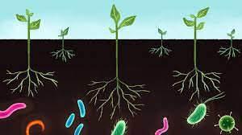
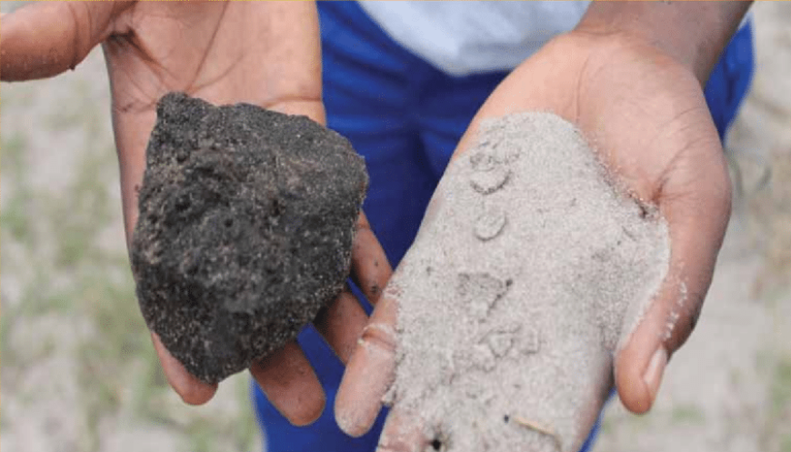
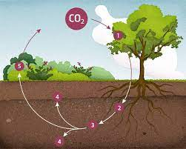
Introduction
Importance of Soil
Soil Organic Carbon(SOC)=Soil Health
[4] Nat.Comm, 2017
[1] UNFAO, 2019
SOC includes many complex compounds
95% of the food we eat comes from topsoil
Low SOC
[2] Plant Sci, 2017
Microbe biodiversity in soil helps crop growth
High SOC
[5] Geoderma, 2019
SOC improves
Soil structure
Biodiversity
Nutrient cycling
Water retention
Pollutant filtration
Crop productivity
[3] Global Change Bio, 1997
Soil is the largest terrestrial carbon sink
Notes:
1st box:
95% of the food we eat comes from __inches of top soil (while showing with finger how fragile)
Soils with high microbial abundance and diversity can support pathogen suppression, increase nutrient availability for crops
soils contain about three times more C than vegetation and twice as much as that which is present in the atmosphere
2nd box:
It includes many, many types including some you might know : peptides, saturated chains, lipids, aromatic, polysaccharides etc
3rd box:
One third of the world’s terrestrial land is tended farmland and by increasing just 0.4% of their SOC we can save this much water, making it robust in climate change induced drought and
Can sequester enough CO2 from the atmosphere to curb the Keeling Curve
Why is soil health important? (1. 90% of world's food source comes from 40cm of topsoil, 2. soil health helps to regulate water storage in terrestrial land, 3. soil holds the 2nd largest carbon stock in the world, more than the plants above it)
What is soil health? (Soil health is most dominantly determined by SOC because SOC helps to harbor microbial life, improve SWHC, aids plants taking up nutrients etc, basically the difference between sand and lush soil is SOC)
SOC is endangered because of unsustainable massive scale industrial farming practices (over the past 40 years, UNFAO has surveyed that global farmland SOC decreased by 70%)
SOC is the biggest source of terrestrial carbon storage and with 5 billion hectares of manageable farmland (third of global land area), even a 0.1% SOC increase over 5 years can hugely curb the CO2 build up curve (include graph to illustrate this calculation)

Slide 3
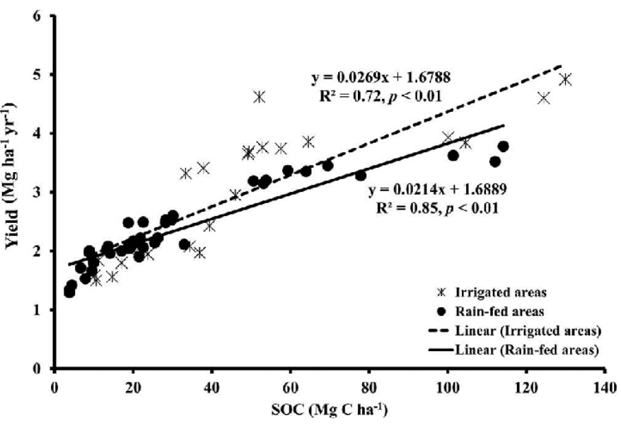
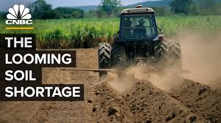
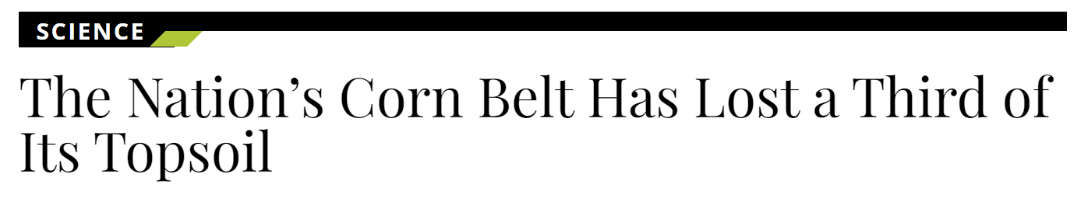
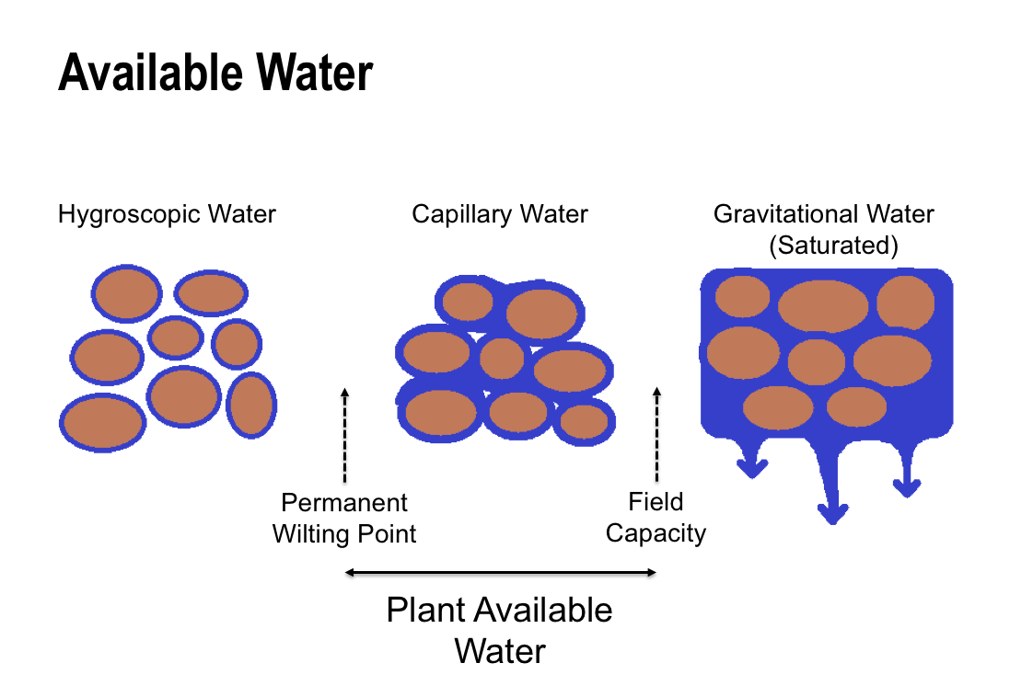
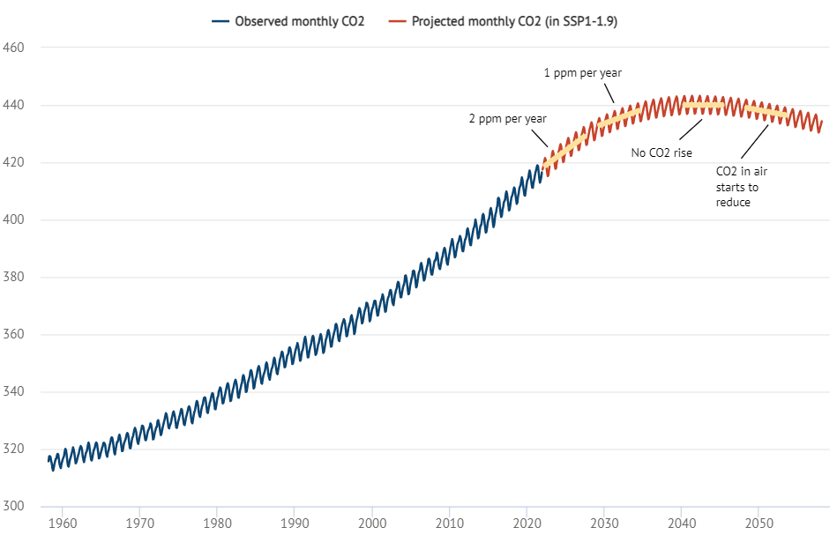
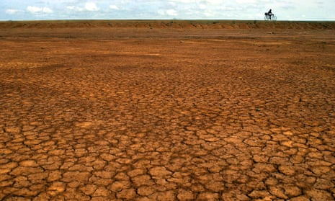
Introduction
Impact of SOC
SOC is being depleted
[6] Soil Sci, 2017
SOC ↑ ↑ ↑ → Yield ↑ ↑ ↑
SOC is being depleted globally with predictions that by 2050 90% of global soil will be degraded
[7] IUCN, 2020
[9] UNCCD, 2020
SOC ↑ by 0.4% → 37 trillion liters of extra water stored
Unsustainable farming
Inadequate fertilizer
Overgrazing etc.
Why farmers want pro-SOC policy
Show there is demand for this
Rising CO₂ due to humans
CO₂ sequestration
by soil
This was once a farmland in Panama
[8] Carbon Brief, 2022
[10] Agri Rev.2020
SOC ↑ by 0.4% → 60 trillion kg of extra carbon stored
Notes:
SOC is not something that you can just spray but it comes from decades and centuries of organic matter stacking (nature) but they deplete so so fast

Slide 4
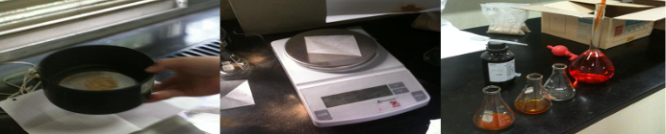
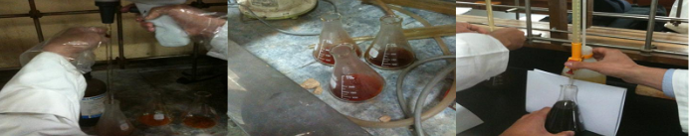
Problem Definition
Slowly, Nations are rising to enact pro-soil policy changes
(54 Commonwealth nations, Japan, France already on-board)
Korea considering to enact this policy [ref]
Pro-soil policy:
If farmer’s land SOC ↑ ↑ ↑ , incentive given
Introduce Carbon Credit system for agriculture industries
Labelling food product as pro-SOC product
Include in 대본
So farmers would want to cut cost on soc monitoring, helping to reduce this cost is helpful and impactful
So we need cost-effective solution to monitor SOC for environment, food security in the future
[11] UNCCD COP15, 2022
In order to enforce this, need to monitor SOC
Current method to measure SOC (Walkley-Black Test)
Send soil to lab
Sieve soil
Weigh exact amount
Add K₂Cr₂O₇ solution
Add concentrated H₂SO₄
Left at room temp.
Titrate with FeSO₄ to get SOC
Too slow, require dangerous chemicals and laboratory setting
→ Not scalable → Need to monitor SOC at global scale and at real-time
[12] Soil & Man., 2007
Notes:
Problem definition
- SOC drop is not noticeable at first but below a certain point the crops and plants above will suffer reduced yield, the soil is unable to hold water even if there is rain etc
- On top of that SOC cannot be restored to healthy levels when SOC drops too much
- Soil is one of the largest carbon banks in th world and since there are
- So SOC needs to be monitored at huge scale globally to both aid SOC preservation efforts by governments (in terms of incentives when farmers raise the SOC of their farmland) and to warn nations of dangerous SOC levels at real-time

Slide 5
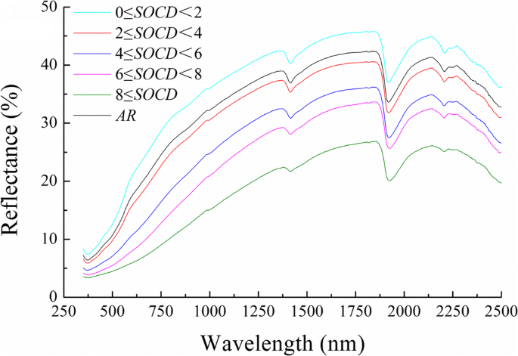
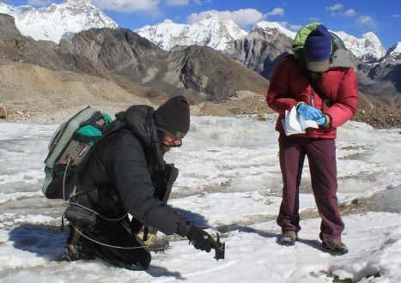
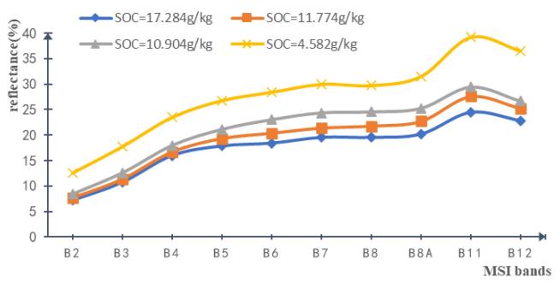
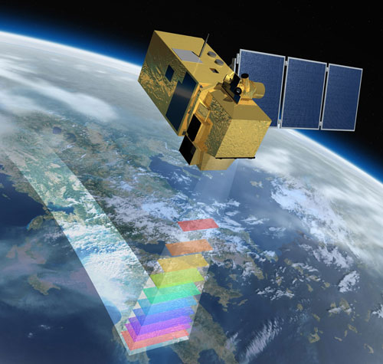
Related Works
Hand-held spectroradiometer
Optical Characteristic of SOC
Hi-Res NG Spectroradiometer
Reading Spectral Reflectance to determine SOC
Spectroradiometer extremely expensive ~ $100,000
Common farmers cannot afford
Not a scalable solution
Increase in SOC
[13] Int. Soil & Water Cons. Res. 2020
Multispectral Satellite Imagery (MSI)
Scalable solution as Sentinel-2 images over entire Earth surface and open-source
Not accurate enough with R² = 0.5712 between predicted and actual SOC
Increase in SOC
…
10 discrete bands instead of continuous spectrum
Sentinel-2 Satellite with revisit time of 5 days Imaging the whole Earth
[14] Remote Sens. 2021
Notes:
Related works
- Current methods of assessing SOC utilize chemical tests (Walkley-Black test) but is time-consuming, expensive and not scalable
- There has been efforts to use portable on ground spectroscopy but these insturments are very expensive (the most portable one is the size of a carrier bag and costs 1억원)
- Taking inspiration from the spectroscopy method multi-spectral imagery satellites have been used to do this but massively lack accuracy due to ground being covered with vegetation, not enough information
Also mention that this won’t work if there is vegetation and clouds

Slide 6
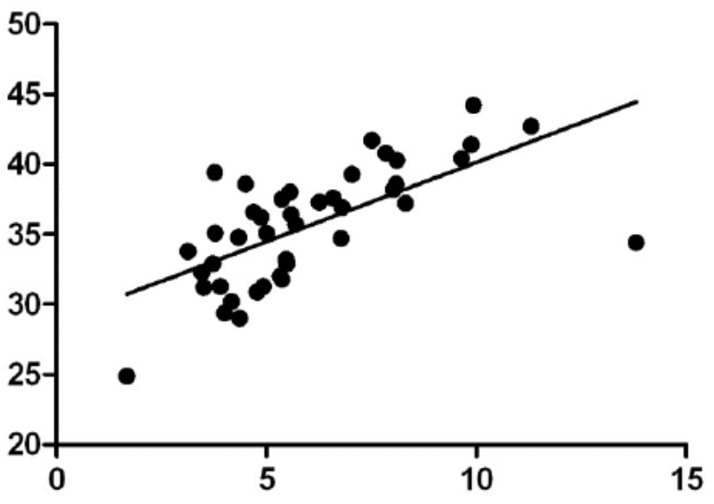
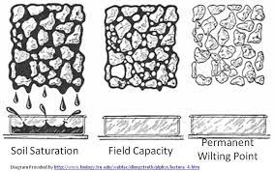
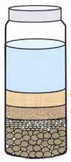
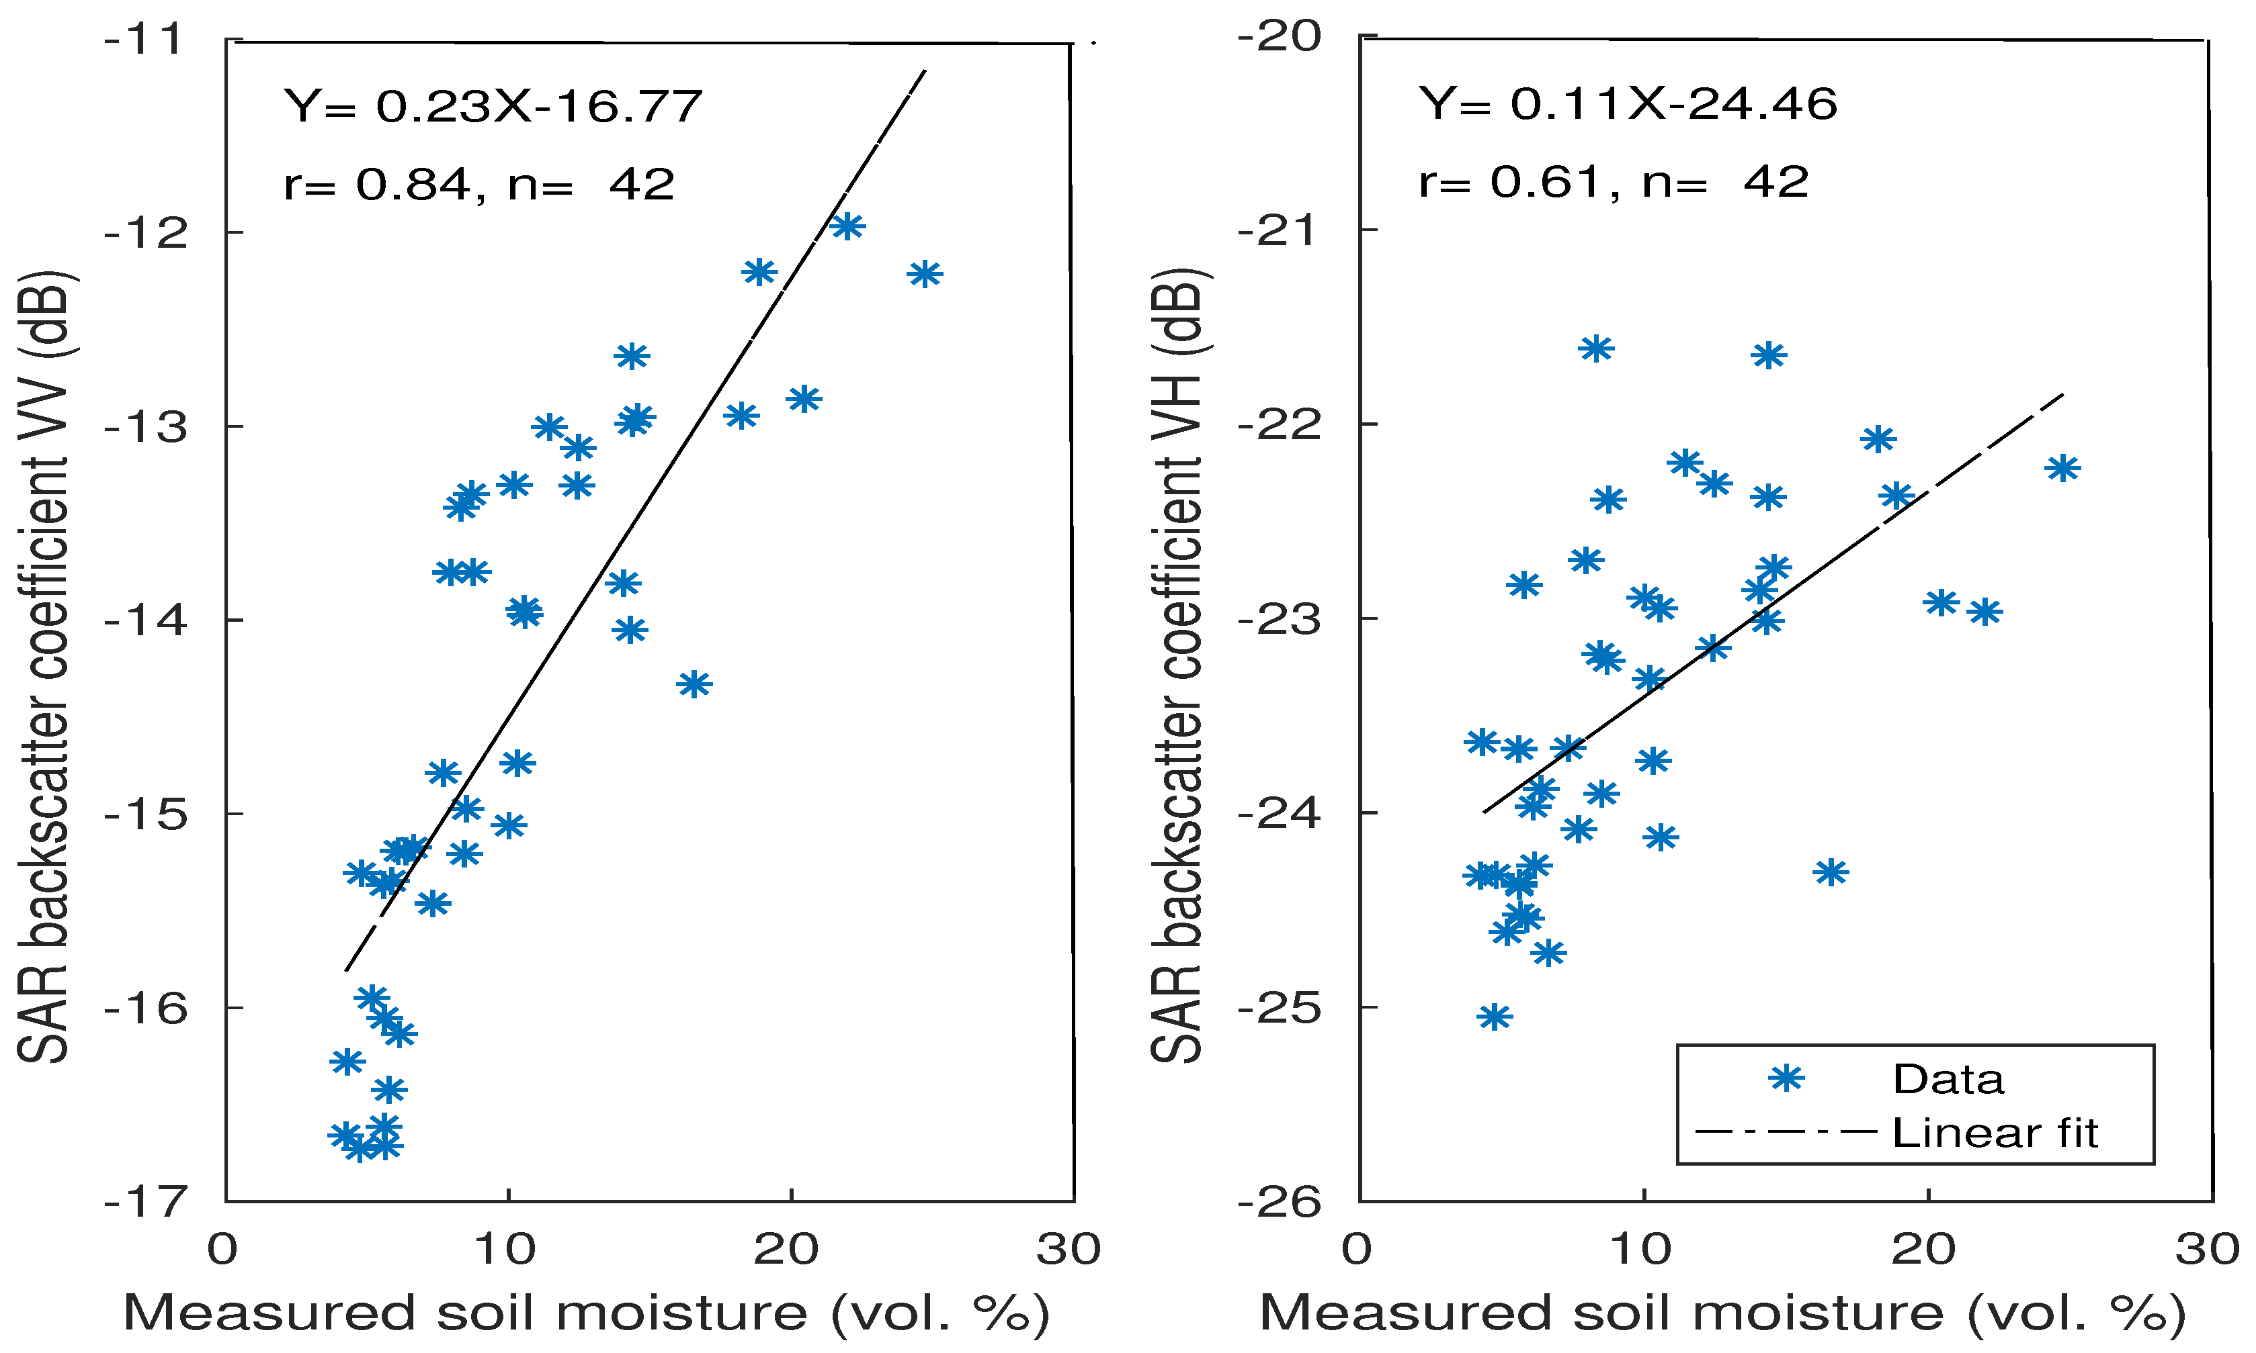
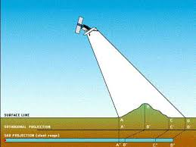
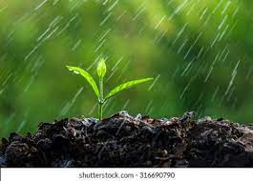
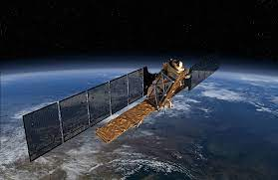
Approach
Approach 1 (Hybrid Remote Sensing)
SOC ↑↑↑ → Soil Water Holding Capacity (SWHC)↑↑↑
Sentinel-2 MSI
SWHC
Soil Texture
H₂O
ML regression model to predict SOC level
SWHC (%)
+
+
Clay
Silt
Improve
Accuracy!
Sand
[15] Int. J. Ecol. Environ. Sci, 2009
SOC (%)
Simple → Anyone (farmers etc.) can test
Cost!
Sentinel-1
Synthetic Aperture Radar (SAR)
Approach 2 (Full Remote Sensing)
Sentinel-2 MSI
SAR b4 rain
Rain
SAR after rain
ML
Reg.
+
Backscatter_{VV} (dB)
More accurate than just Sentinel-2
Radar
Antenna
Soil Moisture (%)
Difference of Soil Moisture b4 and after rain can give us idea how well soil retains water
[16] Remote Sens. 2020
Notes:
Approach
- we use 3 main features to predict the SOC
- 1.Sentinel-2 satellite multispectral imagery can provide 13 discrete spectral information at resolution of 20m. Here we filter our satellite images based on NDVI and BSI which shows us how bare the soil is (if it is covered, the satellite measurement is wrong)
- 2.We include not just average precipitation of the region but also the rainfall over the are for 10 days leading to the date of satellite image acquisition
- 3.SWHC is highly dependent on SOC hence along with sentinel satellite multispectral imagery, we use rudimentary SWHC measuring setup to measure SWHC.
- Also taking inspiration from SWHC we use Synthetic Aperture Radar to measure the soil moisture before and after a rainfall event and add that as a feature.
- We visited farmlands in 이천 to collect topsoil samples and used Walkley-Black test to record label values of the ML algorithm
- We input all these data (1,2,3) into ML algorithm and predict SOC level. This is called remote sensing
Also mention the advantage of S1 not being tackled by clouds

Slide 7
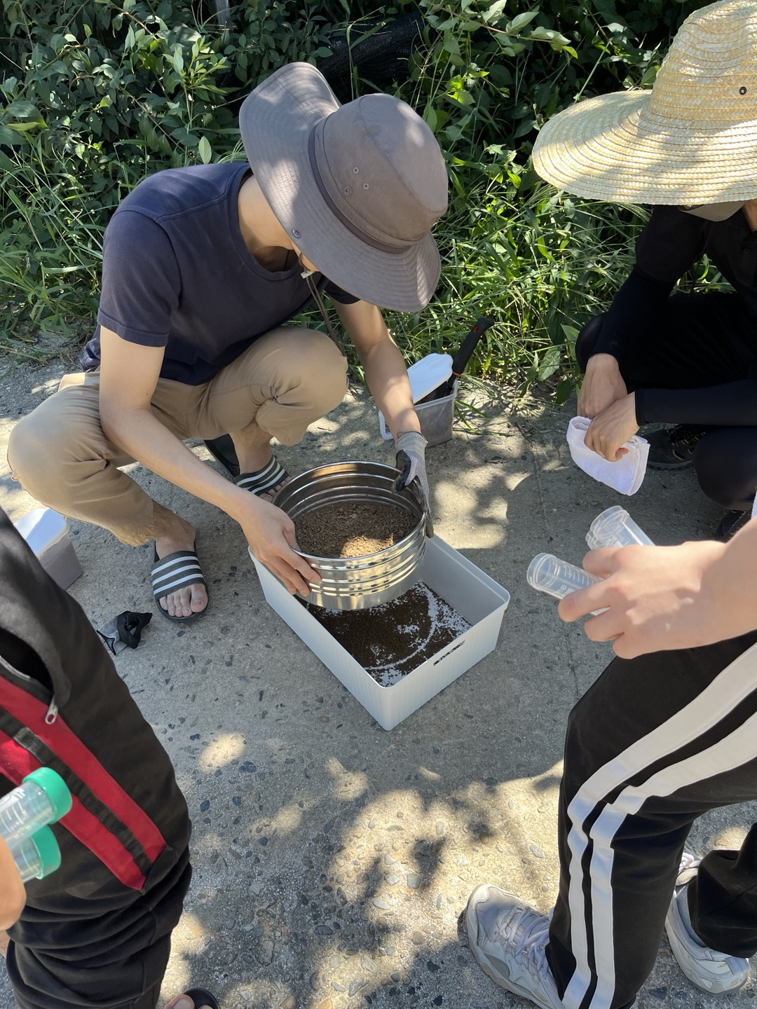
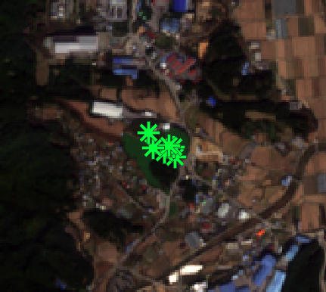
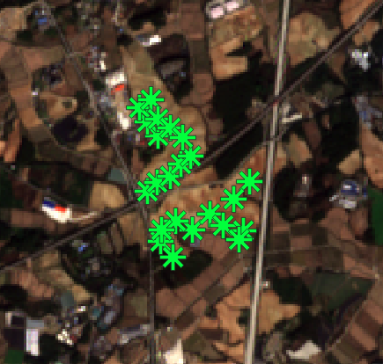
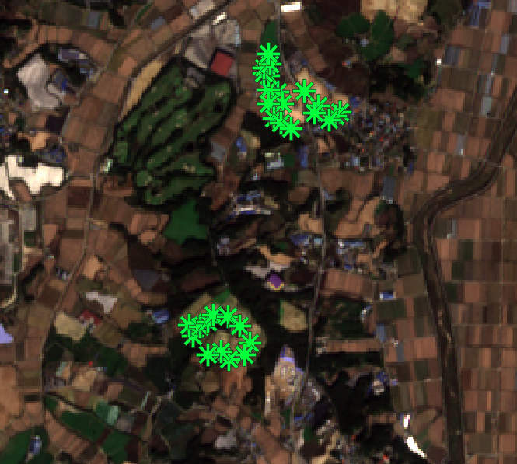
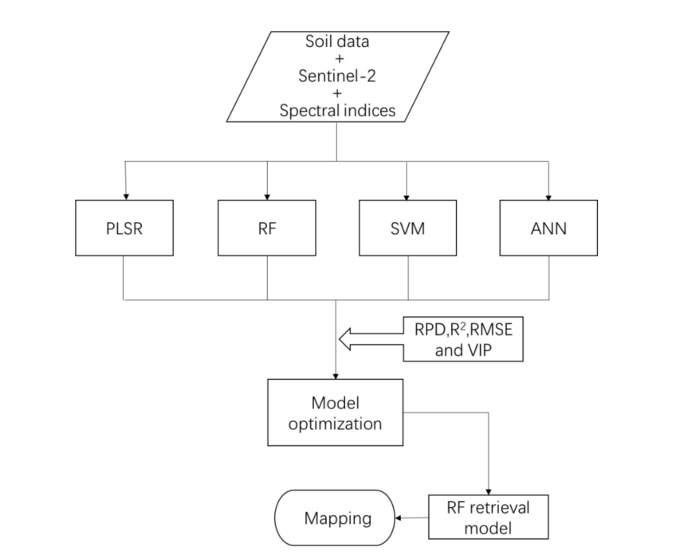
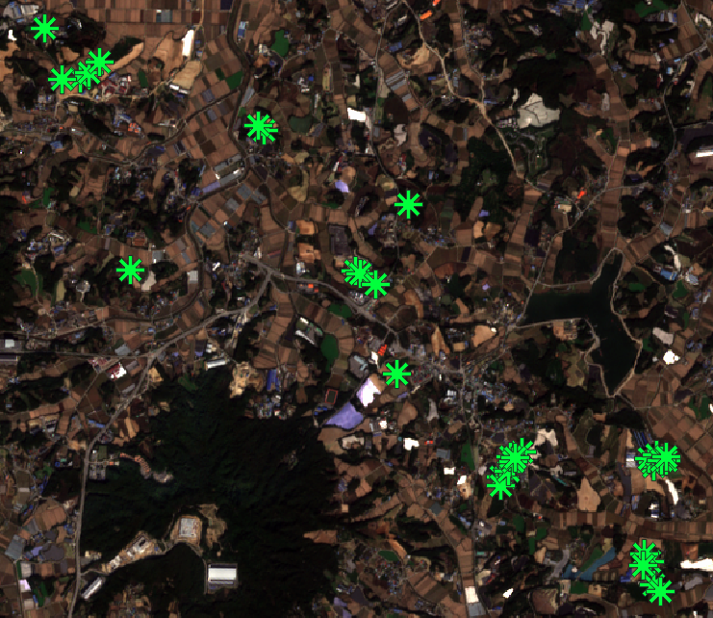
Methods
(1) Select Fields of Icheon using NDVI and BSI
Include US Soil Sampling guide and simple procedures
Show map of sampled points
Sentinel-2 image preprocessing
Select sample location then field trip (selection criteria NDVI, BSI)
Soil measurement (SWHC, ST)
Label making target feature (label) had to do this as there was no open-source soil data so had to collect them

Slide 8
Results (show percentage increase)

Slide 9
Improvements and Summary
Notes:
Use NDVI during peak growing season to add into our features (this alone is very inaccurate) DOI: 10.1080/10106049.2017.1381179

Slide 10
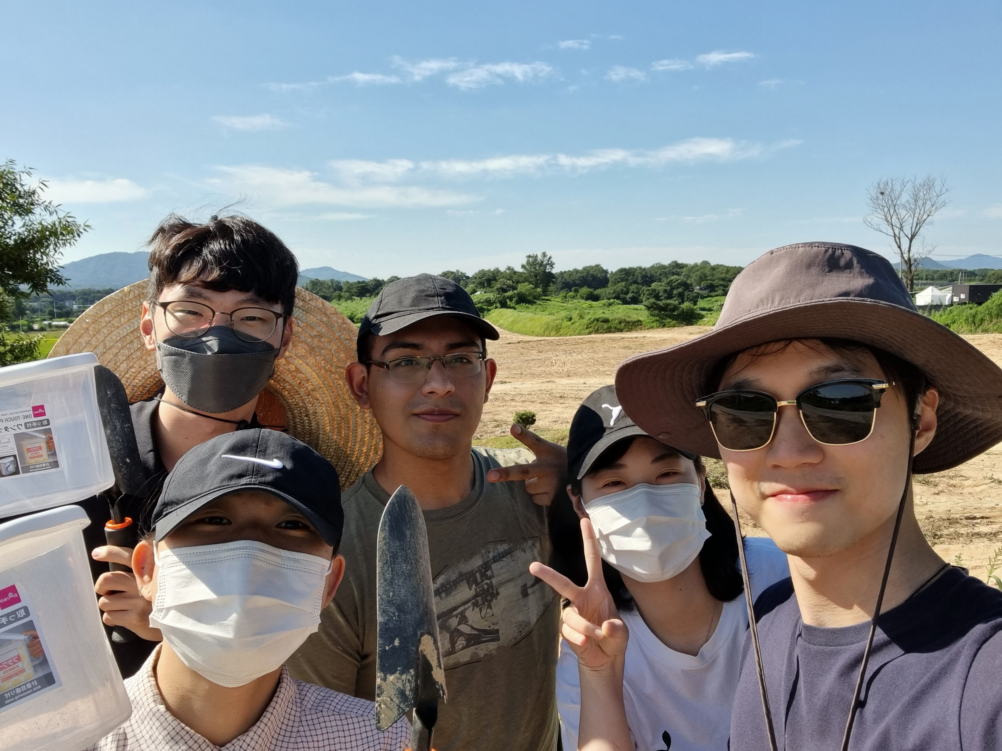
Thank you!
Any questions?

Slide 11
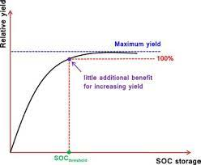
This is for rice but diff for other crops
http://dx.doi.org/10.1080/00380768.2017.1323546
Notes:
If they ask then why not use NDVI to determine yield and hence SOC? Ans: the relationship of NDVI vs Yield is very different for different crops (this is only for rice in intro page) and some show little correlation.
Not only that the effect due to low SOC becomes evident only at low SOC (evident means the effects showing in NDVI), so why don’t we just detect low SOC when this happens? Its cuz I told you intro, raising them takes decades and centuries of work
For the SOC to stick to the soil particle otherwise would just be eroded away. SO once we detect SOC using this way of seeing only the crops above, its too late.

Slide 12
References
[1] UNFAO, 2019
[2] Front. Plant Sci. 8:1617 (2017)
[3] Global Change Biology (1997) 3, 161–173
[4] NATURE COMMUNICATIONS. 8: 396 (2017)
[5] Geoderma 333 (2019) 149–162 (2019)
[6] Soil Science and Plant Nutrition, 63:3, 274-287 (2017)
[7] IUCN, 2020
[8] Carbon Brief, 2022
[9] UNCCD, 2020
[10] Agricultural Reviews.2020.(41):91-105 (2020)
[11] UNCCD COP15, 2022
[12] Soil Use and Management, 23(3), 221-229. (2007)
[13] International Soil and Water Conservation Research 8 , 195e204196 (2020)
[14] Remote Sens. 2021, 13, 1072 (2021)
[15] Int. J. Ecol. Environ. Sci
[16] Remote Sens. 2020, 12(1), 72

